Slide 1

Restaurant Demand Forecasting
Darren Carvalho - 301251637

Slide 2
About
Our goal is to transform the restaurant sector with a cutting-edge sales forecasting system that optimizes revenue, efficiency, and customer satisfaction. Using advanced analytics, we will enhance labor scheduling, inventory control, and strategic decision-making, leading to improved revenue management and superior customer experiences.

Slide 3


Why Demand Forecasting
Circana report: Q1 2023 saw 11% increase in restaurant visits and 18% rise in spending compared to last year's Q1.
Full-service restaurants grew by 24% in traffic, quick-service establishments dominated with 67% share.
Fast-food sector performing better; McDonald's and Restaurant Brands International showing positive results.
Statistics Canada: Food service percentage of total food sales returned to pre-pandemic level (39%).

Slide 4
Project Outline
Create a machine learning model that can predict whether a restaurant will be busy or not based on check-in data from yelp.
Factors involved - Restaurant characteristics, Reviews from customers, Customer insights, Competitive analysis, Sales.
Extracting information about the restaurant location and point of interest parameters.
Understanding the reviews from customers to generate more insights about the popularity of a restaurant which in turn drives customer flux

Slide 5
Data Introduction
Restaurants Data
User Data
Over 14 unique attributes for each restaurant, totaling 209K entries.
Profiles and activity from over 2.5 million users, enriching our insights into customer behaviors
Reviews Data
Check-in Data
A vast collection of 5.5 million customer reviews and ratings.
1.1 million records capturing user check-ins at various restaurants.

Slide 6

Data Exploration

Slide 7
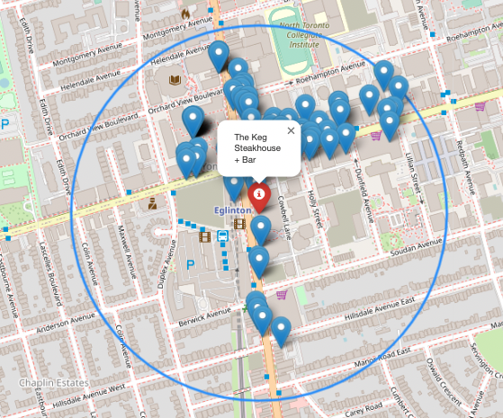
Competitive Analysis
Restaurants have more competitors in Downtown Toronto
This affects customer flux due to multiple Point of Interest
Restaurants with similar characteristics / cuisines pose a greater threat

Slide 8
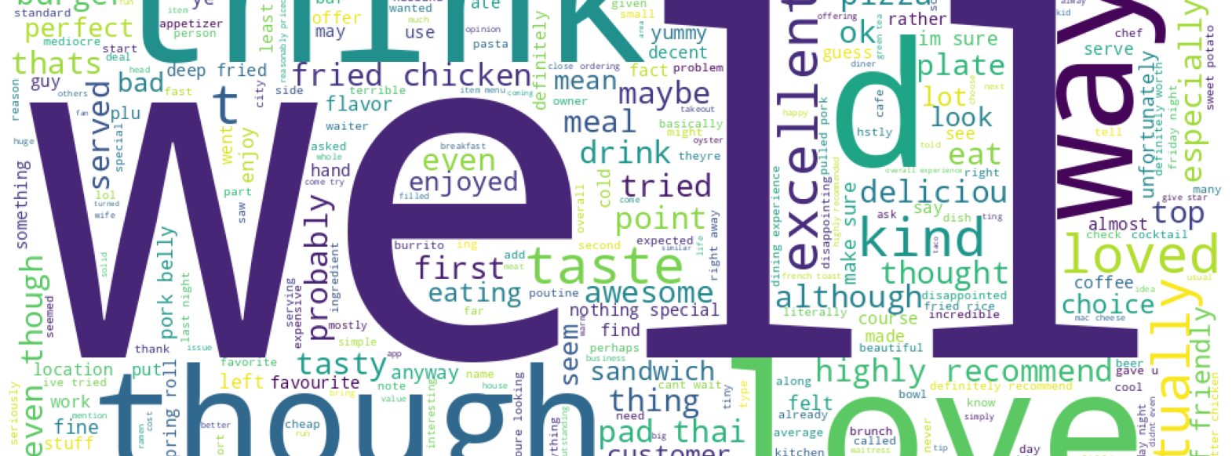
Word Cloud for Reviews

Slide 9
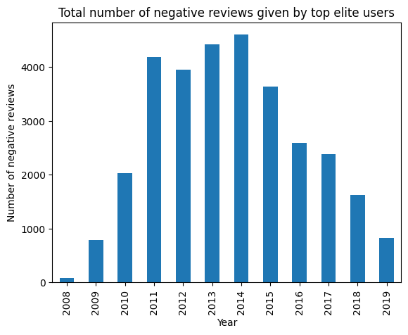
Negative Reviews Analysis
Negative reviews were prominent between 2011 and 2016.
The average star rating each year during this period was also between 3.5 and 3.6
Average rating post for these years was 3.7

Slide 10
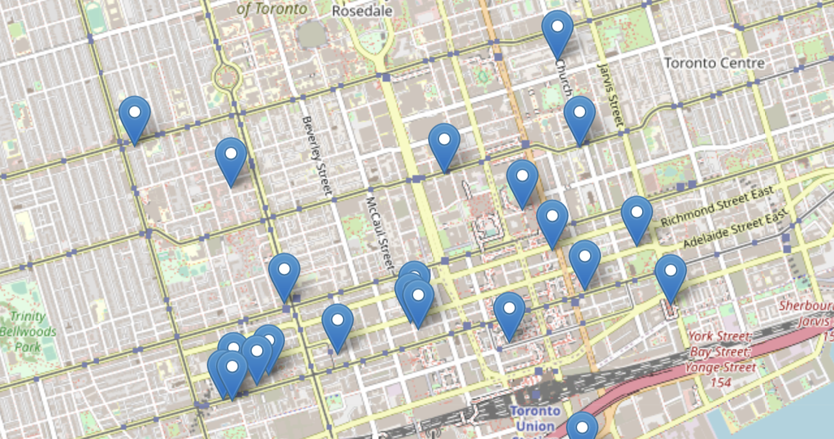
Location of popular restaurants

Slide 11
Assumptions
- Historical sales data is crucial but might not always be open-source; hence, we'll incorporate a mix of other factors for analysis.
- We'll utilize Yelp check-in count to estimate customer visits, exploring its correlation with other variables like online delivery, dine-in, and take-out.
- Emphasis on unbiased reviews to ensure a fair representation of customer opinions and preferences.

Slide 12
Topic Modelling
Latent Dirichlet Allocation (LDA) is a technique used in text analysis to identify hidden topics within a collection of documents. It helps reveal the main themes present in the text data.
Calculates probability of document belonging to a topic and probability of list of words belonging to a topic
It will assist in feature extraction from text data. We selected 10 topics to be modelled.
Output from the model will be used as a feature in the classification model.

Slide 13
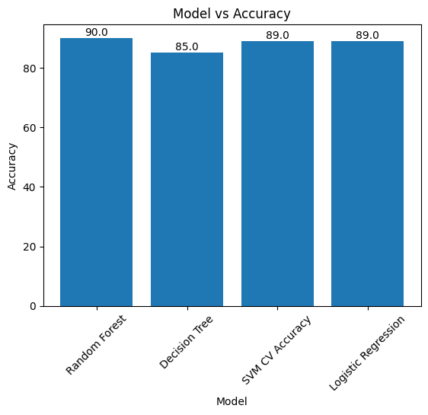
Modelling
The final dataset for modelling had 19 binary variables, 33 numerical variables and 245K records.
Random Forest gave the best model performance among 4 other models with an accuracy score of 90%

Slide 14
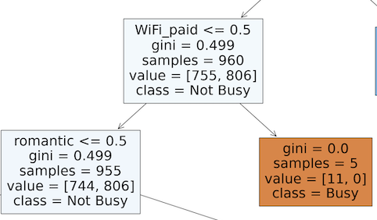
Estimates
The chances of a restaurant being busy increases by 37% if it has received more reviews
If there are more competitors nearby, the likelihood of the restaurant being quiet rises by 90%.
The likelihood of a restaurant experiencing higher activity rises by 5% when its operating hours are extended.

Slide 15
Conclusion and Recommendations
Strategic Expansion
Effective Promotions
Utilize predictive models for identifying high-demand regions and optimal restaurant locations, considering cuisine preferences and operating hours.
Align promotional efforts with forecasted demand surges to maximize their impact, strategically boosting customer turnout.
Efficient Staffing
Smart Inventory Management
Anticipate busy periods with predictive models to optimize staff scheduling, avoiding overstaffing during slower times and ensuring resource efficiency.
Optimize inventory levels with demand forecasts, minimizing waste and costs, and implement just-in-time supply strategies to avoid stockouts.

